Slide 1
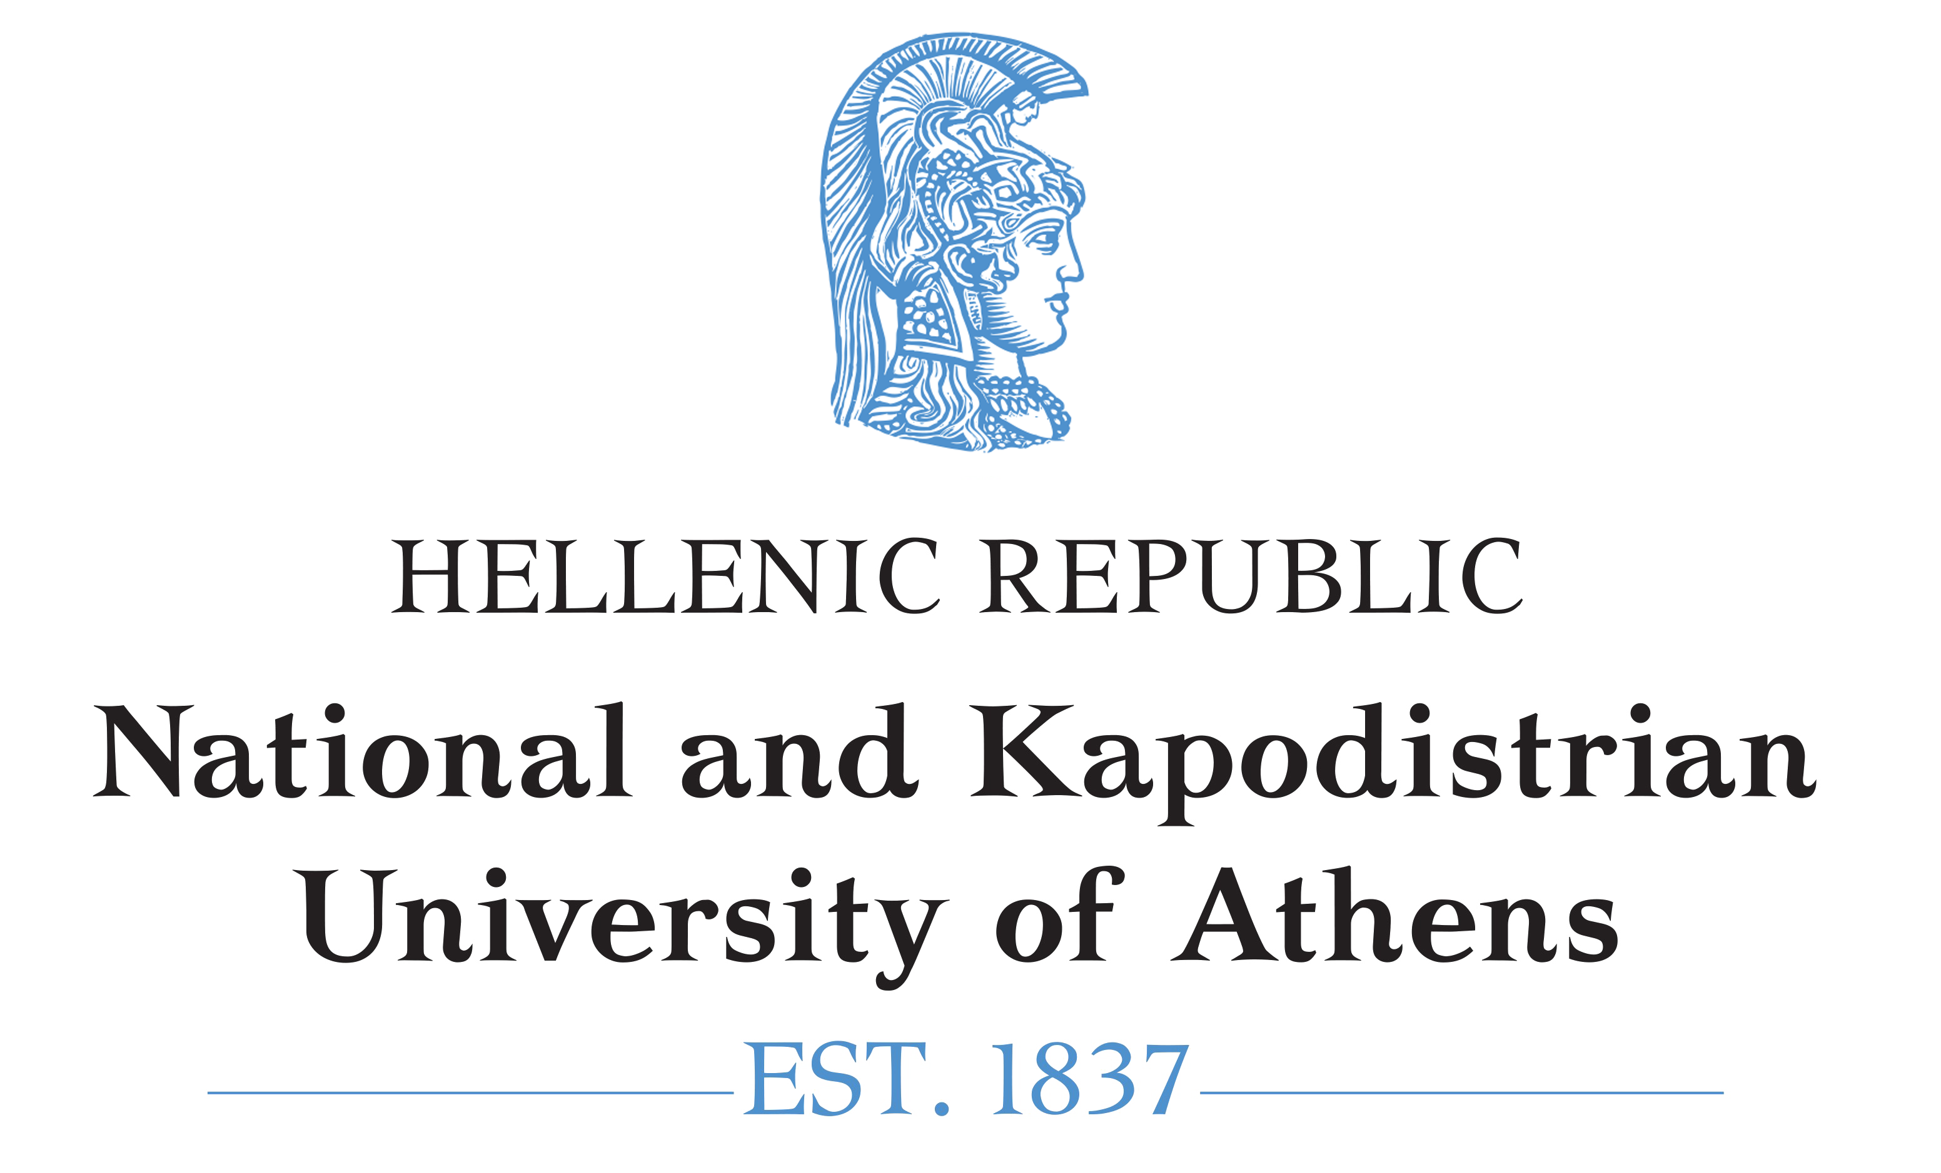
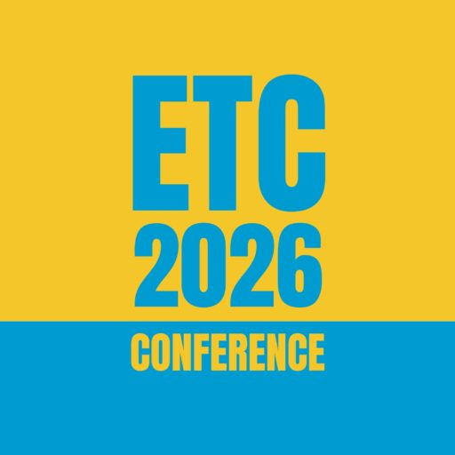
Considering the complexity of the practice of mathematics teaching in teacher education
Despina Potari
ETC 19, Charles University, Prague, 4-7 February 2026

Slide 2
The structure of the presentation
Research on mathematics teaching and its complexity – A historical journey
Research on Mathematics Teacher Education to address this complexity
Three research examples to show how complexity has been addressed in mathematics teacher education
How mathematics teaching complexity has been addressed in mathematics teacher education in this conference
Future directions

Slide 3
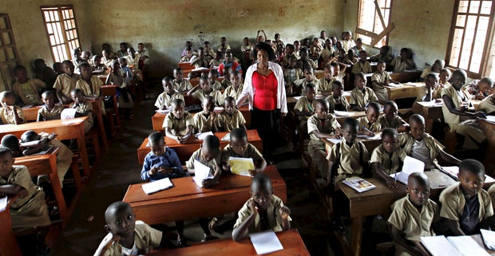

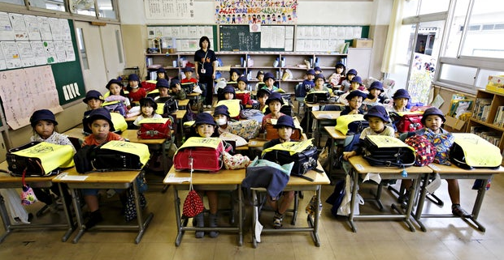
Research on mathematics teaching and its complexity – A historical journey
What are the characteristics of a mathematics classroom?
What is the complexity of mathematics teaching?
Can we talk about one practice/activity of mathematics teaching?

Slide 4
Research on mathematics teaching and its complexity-
A historical journey
Research on students’ thinking
Experimental contexts (interviews – teaching experiments) – concept development
students’ schemes on numbers (Steffe 1988)
students’ schemes on fractions (Steffe & Olive 2009)
students’ schemes on exponential function (Confrey 1991)
Classroom contexts
The role of classroom microculture on the development of students’ reasoning (Cobb et al. 2001; Yackel & Cobb 1996)
Patterns of interaction in different classroom contexts and student’s thinking (Wood, Williams & McNeal 2006) (broader consideration of thinking –recognizing, building with and constructing (Dreyfus et al. 2001)
The development of algebraic thinking in the classroom from a semiotic and cultural perspective (Radford 2010)

Slide 5
Research on mathematics teaching and its complexity-
A historical journey
Going deeper on the practice of mathematics teaching at the micro-level of mathematics classroom
  Holistic ways of understanding mathematics teaching and learning
    (e.g. the use of Teaching Triad – Jaworski 2002; Jaworski 2002; Potari & Jaworski 2002) (Relationships between Management of Learning, Mathematical Challenge, Sensitivity to Students)
  Linking mathematics teaching and mathematics learning – blending the moral and the intellectual
  (Ball et al. 2001)
  Decomposition of the practice of mathematics teaching
    (e.g. Five practices: anticipating, monitoring, selecting, sequencing, and making connections between student responses – Stein et al. 2008; core practices: general
    and content specific – Grossman 2018)

Slide 6
Research on mathematics teaching and its complexity-
A historical journey
Considering social, cultural, political and environmental perspectives in mathematics teaching
  Language issues – difficulties of students and teacher when there is no a common language in the classroom
  (e.g. Gorgorio & Planas 20; Planas 2021)
  Cultural responsive mathematics teaching – multiple dimensions: positive mathematics identities; rigor and support; power and participation (Zavala & Aguirre 2024)
  Interdisciplinary teaching (STEAM) – the role of mathematics in interdisciplinary STEM education
  (Makonye & Moodley 2023)
  Critical citizenship and socio-ecological awareness - promoting academic excellence and equipping students with values for a sustainable and equitable future
  (e.g., Barwell et al., 2022; Valero & Beccuti, 2025)

Slide 7
Reflecting on this journey about the complexity of mathematics teaching
Research on mathematics teaching and mathematics teacher education does not take significantly into account the complexity of mathematics teaching and learning. Research does not consider contextual issues to a large extent to address the complexity (Skott 2019)
Published research shows the under-representation of authors from various world regions and so there is a dominance of the research domain by a few (Darragh et al. 2024). So, our understanding of the mathematics-teaching learning practice is rather mis-leading
The need to build a common language of what we mean by practice (Charalambous and Delaney 2020)
Perspectives have been challenged by colleagues and several questions have been posed

Slide 8
Ways of tackling the complexity of mathematics teaching in mathematics teacher education
Research and practice informed approaches
(Example 1)
Socioecological perspectives
(Example 3)
Inter-disciplinary teaching approaches
(Example 2)

Slide 9
Example 1:
Research and practice informed approaches

Slide 10
Example 1:
Research and practice informed approaches
Ruthven and Goodchild (2015) point out the dialogic cycle between scholarly knowledge and craft knowledge as a way of linking academic research with teaching practice.
Building research and practice in collaborative settings (e.g. teachers with the support of didacticians inquire into mathematics teaching - Jaworski, 2006).
It is demanding in the context of initial mathematics teacher education – Prospective teachers (PTs) do not use research to interpret phenomena of mathematics teaching and learning (Potari 2013; Rottem et al. 2024).
There are attempts to support PTs to use research in mathematics teaching but in a rather linear way. Research results are presented in the context of a course and PTs are expected to link research with mathematics teaching practices in the field experiences (Lendínez et al. 2024).
Teacher learning can be seen as a trajectory of using theoretical tools from research to professional practice in a community of inquiry(Garcia et al. 2006)

Slide 11
Example 1: The interplay of research and practice in mathematics teacher education (Cusi & Potari submitted)
Two mathematics education courses at the university level
(one in Italy and one in Greece)
The focus is on the teacher education tasks (meta-tasks) and on their role on promoting PTs’ learning through a synergic link between research in mathematics education and mathematics teaching practice.
Research question: How can the meta-tasks designed by MTEs be characterised and what potential do they have to support PTs in mobilising research-based theoretical ideas within teaching-related practices?

Slide 12
Example 1: The interplay of research and practice in mathematics teacher education: Theoretical perspectives
A meta-didactical transposition model (Arzarello et al., 2014; Cusi et al., 2022)
Didactical and meta-didactical praxeologies, intended as systems of tasks and techniques to carry out the tasks, and the discourses developed to justify the chosen techniques. These systems support both action in teaching (didactical praxeologies) and reflection on teaching (meta-didactical praxeologies)
The process through which external components become internal components, referred to as internalisation - the transformation of praxeological components through discussion between different communities
Boundary objects BOs objects of joint actions carried out by actors belonging to different communities - Means of promoting internalisation
Carlile’s (2004) characterisation of three levels of action on BOs (i) syntactic level (transfer); (ii) semantic level (translation); (iii) pragmatic level (transformation)

Slide 13
Example 1: The interplay of research and practice in mathematics teacher education: Results
Research practices | Teaching practices
R1: Searching for research papers R2: Reading research papers R3: Presenting theoretical ideas R4: Reviewing R5: Designing research R6: Using theoretical and research ideas for data analysis R7: Justification of research choices | T1: Identifying key teaching and learning issues T2: Selecting mathematical tasks T3: Designing lessons T4: Enacting lessons T5: Assessing students’ work T6: Evaluating/Analysing lessons

Slide 14
Example 1: The interplay of research and practice in mathematics teacher education: Results
Core-Meta-tasks | R and T practices
ΜΤ1: From the analysis of classroom phenomena to the emergence of theoretical ideas | PTs analyse classroom data provided by the MTE (T6). MTE presents theoretical ideas (R3) and highlights the links (R7) between T6 and R3 or asks PMTs to make these links explicit (R7)
ΜΤ2: From the introduction of theoretical ideas to the analysis of classroom phenomena | MTE presents research findings and theoretical ideas (R3). PMTs analyse classroom data (T6) using theoretical tools (R6). MTE highlights the links (R7) between R3 and T6
MT3: theoretical ideas as means for designing and justifying the teaching design | PMTs use theoretical models (R6) to design tasks or hypothetical classroom dialogues (T3). PMTs justify the links (R7) between R6 and T3
MT4: peer review | PMTs review peers’ designs (R4-T6). PMTs reflect on the links (R7) between R4 and T6
MT5: guided readings of research papers | PMTs read and present a research paper (R2-R3) to identify key teaching and learning issues (T1). MTE asks guiding questions promoting PMTs’ reflection on R2 and on the links (R7) between R2-R3 and T1
MT6: design/re-design of tasks/activities using theoretical ideas | PMTs select mathematical tasks (T2). Then PMTs design a lesson (T3) using theoretical ideas discussed in the course but selected by their own (R6) and justify their design on theoretical basis (R7). MTE and PMTs provide feedback (T5) about the link (R7) between T3 and R6
MT7: design of a research lesson | PMTs engage in designing a research lesson (R5-T3). PMTs present their research lesson in the course (R3). MTE and PMTs provide feedback (T5) about the links (R7) between R5 and T3

Slide 15
Example 1: The interplay of research and practice in mathematics teacher education: An analysis of MT3
PTs are asked to
design teaching artefacts such as sequences of mathematical tasks, lesson plans, or hypothetical classroom discussions
PMTs must mobilise theoretical constructs autonomously to justify their design decisions
make sense of the theoretical constructs and negotiate how these constructs inform design choices (semantic level) as meanings associated with the theoretical constructs are interpreted, refined, and discussed among peers in relation to the artefacts being designed
justify their design choices by explicitly referring to theoretical constructs or analytical tools introduced during the course.
Group work and collective discussion, where PMTs present their designs and receive feedback from peers and the MTE
Interests may diverge during interaction and may lead to a reorganisation of the design and to a re-alignment of theoretical justifications (shift to a pragmatic level ), in which theoretical constructs begin to function as tools for guiding design decisions and for justifying them in accountable ways.

Slide 16
Example 1:
Research and practice informed approaches: Conclusions
The potential of meta tasks to link research and practice
(a demanding endavour)
The role that specific objects, such as classroom data, theoretical constructs, design products and research lesson plans, may play as potential BOs that mediate the relationship between R and T practice.
The role of teaching practice (videos of classroom, hypothetical classroom scenarios, classroom dialogues) embedded in theory and research through the process of justifying and interpreting this practice

Slide 17
Example 2:
Inter-disciplinary teaching approaches

Slide 18
Example 2:
Interdisciplinary teaching approaches (STEAM)
Epistemological questions about the meaning of inderdisciplinarity and of tensions related to the interaction between the activity of the different disciplines (Williams and Roth 2019)
Meaning of interdisciplinarity related to connections within and between knowledge (e.g. content) and practice (e.g. Inquiry) (different forms of integration) –(Yang and Ball 2024)
“Mathematics teachers be provided with opportunities to cooperate with other disciplinary experts and learn from each other’s knowledge, practices and affect through planning, designing and implementing STEM integrated teaching.” –(Yang and Ball 2024, p. 205)
Theoretical constructs and methodological tools (Activity Theory, Communities of Practice, Boundary Crossing)
Challenges of the MTE to support teacher collaboration between teachers of different disciplines mainly of handing the epistemological contradiction between sciences and mathematics (Triantafillou et al. 2021)

Slide 19
Example 2:
Art and mathematics teacher collaboration
Τhe process and the outcomes of collaboration
  What are the emerging boundaries between MT and AT communities of practice?
  How are these boundaries handled among members in the collaborative group discussions in the process of developing an integrated practice?
Choutou, C., & Potari, D. (2024). Investigating boundaries and boundary crossing between mathematics and visual art teaching in a collaborative setting. The Journal of Mathematical Behavior, 73, 101138.

Slide 20
Example 2:
Theoretical perspectives (the meaning of practice)
Communities of practice (CoP) (Wenger, 1998)
    CoP of mathematics teaching
    CoP of art teaching
    Building a hybrid community
    The process of boundary crossing
    (coordination, transparency, negotiability)

Slide 21
Example 2:
The study: Data and analysis
An one year ethnographic research in two lower secondary art schools to identify existing teaching practices and establishing conditions for collaboration
Collaboration was established at the level of school and lasted for a year
(8 art teachers, 3 mathematics teachers and 1 facilitator)
Two phases of collaboration: Familiarization, design/enactment, reflection
(17 collaborative meetings)
First grounded analysis was done with the use of Atlas.ti resulting to categories and subcategories
Tensions and the implied boundaries were identified (1st phase)
Identified episodes around the boundary to study the process of handling it
(who was negotiating the boundary, what aspect was being negotiated and how it was negotiated)
(2nd phase)
Reification through the 4 learning mechanisms (Akkerman & Bakker 2011) to trace learning
(2nd phase)

Slide 22
Example 2:
Findings: Boundaries (Mathematical and art practices)
Boundary (frequency) | Description
Analytical or visual ways of thinking (171) | Mathematics teachers usually use symbolic and algebraic forms whereas art teachers think in terms of images.
Mathematics or applications of mathematics (54) | Members contrast the engagement with mathematical concepts, theories or processes to their application in AT.
Abstract or concrete objects (45) | Members seem to stress an abstract nature of mathematical objects in mathematics, whereas art teachers highlight a concrete nature of mathematical objects in arts.
Pointwise or holistic visualization (45) | When looking into an image or diagram, the mathematics teachers focus on specific parts or a unit and observe relations, whereas the art teachers look at it as a whole.

Slide 23
Example 2:
Findings: Boundaries (tools)
Boundary (frequency) | Description
Geometrical instruments or empirical artifacts (12) | In MT, geometrical instruments are used, while in AT, empirical artifacts are used.
Formal or informal terms (27) | Formal terms in MT emerge in contrast to informal ones in AT.
Signifier or signified (44) | Common concepts in AT and MT share the same terms but have different meanings or representations. Also, artifacts with different terms may share the same meaning.

Slide 24
Example 2:
Findings: Boundaries (teaching practices)
Boundary (frequency) | Description
Students’ negative or positive feelings (17) | Both mathematics and art teachers suggest that students’ feelings seem to be more positive towards art than towards mathematics.
Non-coordination (74) | Curriculum content and its sequence of one discipline might not be relevant to the other. Also, institutional structures do not allow synchronizing (e.g., time schedules, different classrooms).
‘Knowing’ or ‘creating’ (40) | The mathematics teachers aim for students’ engagement with mathematical content, while the art teachers aim for students to develop creativity and construction skills.

Slide 25
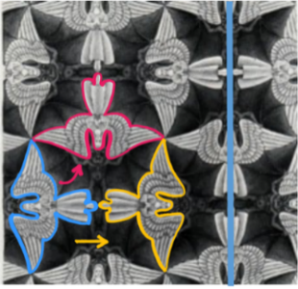
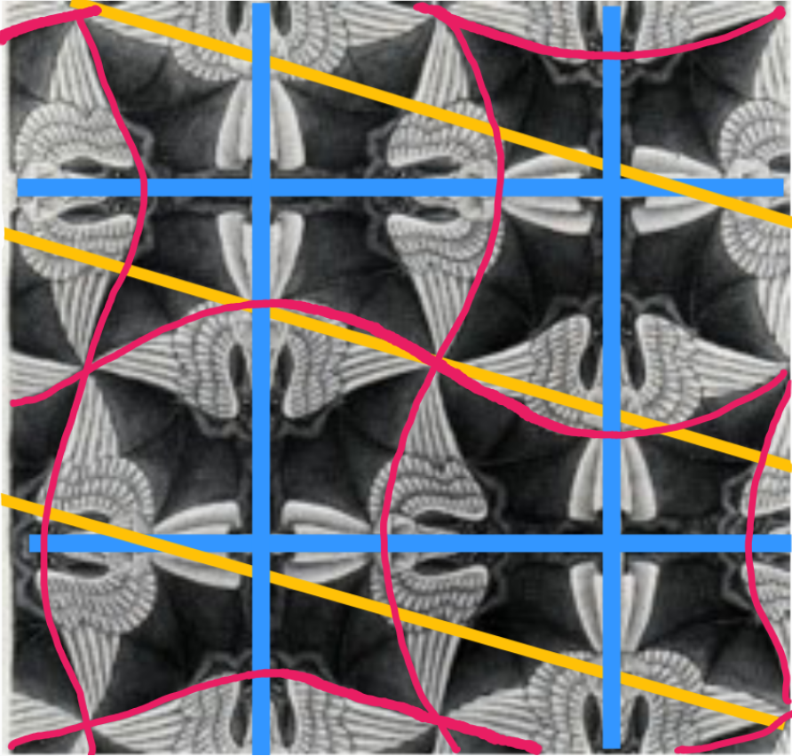
Example 2:
Findings: Examples of boundaries
In GM14, when inquiring about why the pentagon does not tessellate the plane, MT1 came up with the algebraic formula, whereas AT1 engaged in a visual inquiry in dividing the regular polygons into triangles in order to see what is happening with the angles (Analytical or visual)
Maria and Melanie focused on the unit-figure of an angel and mentally transformed it via reflection and rotation so as to generate the whole painting (figure 1), while the art teachers focused on the whole image of the tessellation pattern and the supporting axes underneath (figure 2):
Pointwise or holistic visualisation
Figure 1
Figure 2

Slide 26
Example 2:
Findings: Patterns and shifts of handling MT and AT boundaries
Participation and negotiation:
From two separate ways of thinking to an integrated one while negotiating connections between MT and AT
Reification:
Building connections between MT and AT via an integrated way of thinking
Shifting from negotiating the two boundary aspects independently to negotiating their integration, from familiarization up to reflection.

Slide 27
Example 2:
Developing the integrated practice: Reflections for teacher education
Inquiring about connections
Identifying knowledge gaps and different ways of thinking
Explaining the practices to each other and searching for ways to coordinate the different aspects
Finding specific ways to link the two teaching practices
  - starting from an initial teaching goal and designing ways of integration (e.g., the transfer/application of mathematics into the art context)
  - reifying which of these links were successful and negotiating what can be improved

Slide 28
Example 3:
Socio-ecological perspectives

Slide 29
Example 3:
Socio-ecological perspective in mathematics education
Task design - the use of wicked problems – tasks that intentionally embed dilemmas and value conflicts to mobilize students’ engagement with both the intellectual and practical dimensions of sustainability (Fred et al. 2025).
Designing tasks that simultaneously promote mathematical inquiry and sustainability awareness is complex, involving tensions such as task openness and alignment with learners’ prior knowledge (Maass et al. 2023).
Shifting from the individual to community, political, ethical and ecological contexts (Coles 2023) – what (work in cross-curricular groups) how (meta-practice of communication with teachers so that their concerns are at the fore)- working towards dialogic ethics.

Slide 30
Example 3:
Socio-ecological issues in mathematics teacher education
(Potari, Triantafillou, Psycharis, submitted)
Rationale:
Linking research with socio-ecological perspectives and teaching practice focusing on the MTE and on the PTs
Research questions:
  How does the MTE integrate socio-ecological dimensions into a mathematics teacher education course?
  - How do the PTs consider the integration of socio-ecological and mathematical dimensions in their research reports?

Slide 31
Example 3:
Socio-ecological issues in mathematics teacher education:
Context of the study
A master’s course on ‘Teaching and learning mathematics through problem-solving processes’ where the research and the practice based perspectives are interwoven.
Mathematics curriculum in Greece does not include modelling tasks, authentic situations and project work allowing students for mathematical and scientific inquiry
The Mathematics teacher educator (MTE) in this course has the research expertise on mathematics in out of school settings, on modelling of authentic situations and the last years on socio-scientific issues

Slide 32
Example 3:
Socio-ecological issues in mathematics teacher education:
ΜΤΕ’s teacher education practices
Modifying the course to include a part of socio-ecological perspectives in mathematics education
Designing and adapting tasks related to socio-ecological issues at global and local level to be mathematically challenging and to promote socio-ecological awareness
Several enactment actions
  - Linking theory and research (e.g. discussion of the extended modelling cycle of Mass et al. 2019). Asking questions to promote reflections
  - Employing key actions to highlight ways of linking mathematics and socio-ecological issues (representations, analysis, problem solving, inquiry questions (mathematical, scientific, socio-ecological)
  - Supporting PTs’ decision-making in task selection for classroom teaching
  - Providing a repository of tasks related to socio-ecological issues
  - Asking PTs to transform typical curriculum tasks to address socio-ecological issues
  - Asking PTs to design and enact a lesson addressing socio-ecological issues and analyse students’ work producing a research report

Slide 33
Example 3:
Socio-ecological issues in mathematics teacher education:
Prospective teachers’ designs and enactment
Analyzing PTs’ research reports
  (PT1) Problem posing in authentic situation (microplastics and pollution)
  (PT2) Modelling activity (life in polluted lakes)
  (PT3) Debate on deforestation
- Different degrees of interplay of mathematical activity and socio-ecological awareness
  different paths on interplay
  mathematics implicit or explicit (concepts and processes)
  Justifications/purposes

Slide 34
Example 3:
Socio-ecological issues in mathematics teacher education
MTEs need to support PTs to identify links between teaching practice and the current research findings in the mathematics education research community as a meta-perspective of their own learning (Coles, 2023).
PTs were free to choose a socio-ecological phenomenon, design and enact their own task and present their teaching intervention in a typical research report format.
Teaching practice: joint activity between students and teachers embedding socio-political issues
Teacher education practice: Designing and reflecting based on research as a way of justification and analysis of the teaching practice

Slide 35
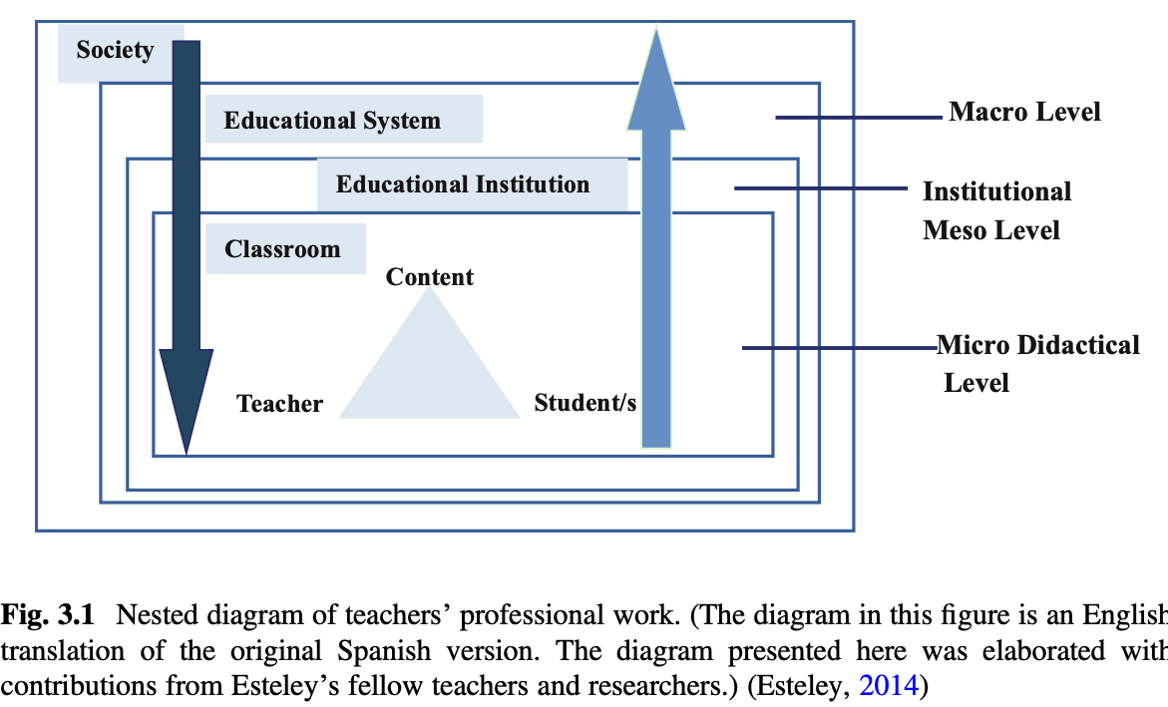
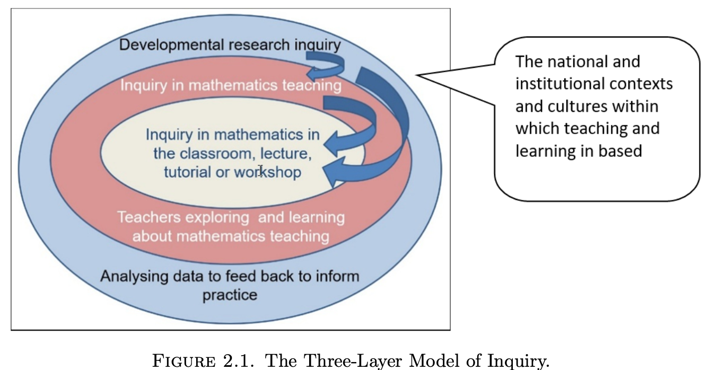
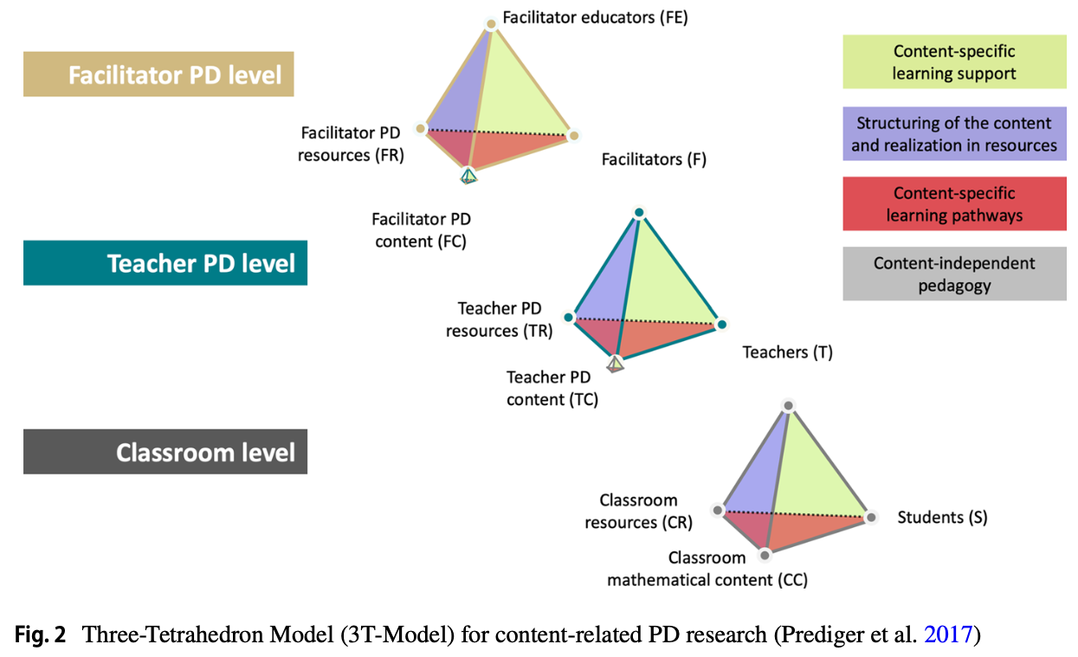
Interrelations of different layers of practice (classroom, working with teachers, didacticians/researchers)
Gómez-Chacón et al.
(2021, p.21)

Slide 36
How mathematics teaching complexity has been addressed in the teacher education? papers of WG1 - Teaching practice at school level
Students’ activity (sense-making, thinking, reasoning, misconceptions (AI), visually impaired student’s spatial thinking and orientation, students’ written solutions, students’ errors)
Socio-cultural and socio-political perspectives (institutional conditions)
Mathematical
(problem solving,epistemology)
Teaching design – enactment -reflection (e.g. student thinking and pedagogical practice, approximations of practice, decomposition of teaching to practices; computer based assessment, tasks, affect, tools, communication)

Slide 37
How mathematics teaching complexity has been addressed in the teacher education? papers of WG1 - Teacher education
- Analysing students’ activity in simulations of practice or in written or digital tools (e.g students’ work, interacting with the student, interpreting work, discussing with the teacher educator; computer based assessment, national tests, AI tools)
- Reflecting on classroom mathematics teaching (analysis of lessons in video or in real classroom observations of their own and others teaching)
- Integrating mathematical and didactical activities individually and collectively (e.g. Lesson Study, Study of Research Path, the cycle of designing, enacting, reflecting, mathematics laboratory)
Teachers’ (mainly prospective) difficulties to “transfrom” teacher education experiences into the school practice (co-existence of different classroom teaching practices)
Affect and knowledge on the practice of mathematics teacher educators
Designing classroom tasks and lessons
Designing classroom
tasks and lessons
Teachers’ (mainly prospective) difficulties to “transfrom” teacher education experiences into the school practice (co-existence of different classroom teaching practices
Affect and knowledge on the practice of mathematics teacher educators
Analysing students’ activity in simulations of practice or in written or digital tools (e.g students’ work, interacting with the student, interpreting work, discussing with the teacher educator; computer based assessment, national tests, AI tools)
Reflecting on classroom mathematics teaching (analysis of lessons in video or in real classroom observations of their own and others teaching)
Integrating mathematical and didactical activities individually and collectively (e.g. Lesson Study, Study of Research Path, the cycle of designing, enacting, reflecting, mathematics laboratory)

Slide 38
How mathematics teaching complexity has been addressed in the teacher education? papers of WG1
Emerging issues
  Theoretical perspectives mainly related to teacher knowledge in relation to the practice of teaching. Few use ATD (2), Communities of Practice (1), socio-political (1)) Noticing (2)
  Qualitative methods are adopted in a combination of grounded and theoretical data analysis processes
  The practice-based perspective of mathematics teacher education is central through the interplay of different teacher education practices (solving tasks, analysing lessons, designing, enacting lessons, reflecting on the enactement)
  The research/theory perspective of mathematics teacher education is rather limited. In very few papers teachers developed their designs and interpretations based on research and theory.
  Few papers refer to the social, institutional contexts and practices but they do not consider them systematically in their analysis
  The way that the practice of classroom teaching is connected to mathematics teacher education is rather linear where the practice of classroom teaching is the reference.
  The dynamic process of the development of teaching that the three layers of Jaworski is rather implicit in the papers of WG1.

Slide 39
Further development in the relationship between teaching practice and teacher education
Considering the teaching practice in a more dynamic and holistic way taking into account contextual conditions
Incorporate in teacher education new dimensions promoted in the mathematics curriculum in the different countries and beyond them
Transform our long research experiences on mathematics teaching and mathematics teacher education to integrate new perspectives with which we are not familiar
Make closer links between mathematical inquiry, teaching inquiry and research inquiry

Slide 40
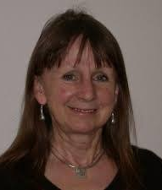
Closing
Jaworski (2004) describes inquiry as a way of being that develops collectively within Communities of Inquiry through the three-layer model.
This process will continue supporting our work as researchers, mathematics teacher educators who aim teachers to develop this inquiry stance in their professional life as a way of developing mathematics teaching and learning at school.

Slide 41
Thank you

Slide 42
References
Ball, D. L., & Wilson, S. M. (1996). Integrity in teaching: Recognizing the fusion of the moral and intellectual. American educational research journal, 33(1), 155-192.
Ball, D. L., Lubienski, S. T., & Mewborn, D. S. (2001). Research on teaching mathematics: The unsolved problem of teachers’ mathematical knowledge. Handbook of research on teaching, 4, 433-456.
Barwell, R., Abtahi, Y., & Hauge, K. H. (2024). Collectivist and individualist values in mathematics education. In Values and Valuing in Mathematics Education: Moving Forward into Practice (pp. 57-71). Singapore: Springer Nature Singapore.
Charalambous, C. Y., & Delaney, S. (2020). Mathematics teaching practices and practice-based pedagogies: A critical review of the literature since 2000. International handbook of mathematics teacher education, 1, 355-390.
Cobb, P., Stephan, M., McClain, K., & Gravemeijer, K. (2001). Participating in classroom mathematical practices. The journal of the Learning Sciences, 10(1-2), 113-163.
Coles, A. (2023). Towards a socio-ecological practice of mathematics teacher education. AIEM - Avances de investigación en educación matemática, 23, 19-35. https://doi.org/10.35763/aiem23.5489
Confrey, J. (1991). The concept of exponential functions: A student’s perspective. In Epistemological foundations of mathematical experience (pp. 124-159). New York, NY: Springer New York.
Darragh, L., Brodie, K., Halai, A., Planas, N., Potari, D., Santos-Trigo, M., Scheiner, T. & Walkoe, J. (2024). Publishing mathematics education research in English: Amplifying voices from the field. Journal of Mathematics Teacher Education, 27(5), 857-878.
Dreyfus, T., Hershkowitz, R., & Schwarz, B. (2001). The construction of abstract knowledge in interaction. Cognitive Science Quarterly, 1, 307-368.

Slide 43
References
Gómez-Chacón, I. M., Hochmuth, R., Jaworski, B., Rebenda, J., Ruge, J., & Thomas, S. (Eds.). (2021). Inquiry in university mathematics teaching and learning: The PLATINUM Project. https:// is. muni. cz/publi cation/ 18254 22/ Kniha_ Plati num. pdf https:// doi. org/ 10. 5817/ cz. muni. m210- 9983- 2021.
Gorgorió, N., & Planas, N. (2001). Teaching mathematics in multilingual classrooms. Educational studies in mathematics, 47(1), 7-33.
Grossman, P. (ED.) (2018). Teaching core practices in teacher education. Cambridge,MA: Harvard Education Press.
Jackson, A., Serbin, K. S., & Bae, Y. (2024). Prospective and in-service teachers’ use of pedagogical mathematical practices in approximations of teaching practice. Journal of Mathematics Teacher Education. https://doi.org/10.1007/s10857-024-09669-9
Jaworski, B. (2002). Investigating mathematics teaching: A constructivist enquiry. Routledge.
Jaworski, B. (2006). Theory and practice in mathematics teaching development: Critical inquiry as a mode of learning in teaching. Journal of mathematics teacher education, 9(2), 187–211.
Jaworski, B. (2002). Sensitivity and challenge in university mathematics tutorial teaching. Educational Studies in Mathematics, 51(1), 71-94.
Makonye, J. P., & Moodley, N. P. (2023). Connecting mathematics to STEM education: interdisciplinary teaching and learning facilitation. ZDM–Mathematics Education, 55(7), 1365-1373.

Slide 44
References
Planas, N. (2021). How specific can language as resource become for the teaching of algebraic concepts?. ZDM–Mathematics Education, 53(2), 277-288.
Potari, D., & Jaworski, B. (2002). Tackling complexity in mathematics teaching development: Using the teaching triad as a tool for reflection and analysis. Journal of Mathematics Teacher Education, 5(4), 351-380.
Potari, D. (2013). The relationship of theory and practice in mathematics teacher professional development: an activity theory perspective. ZDM, 45(4), 507-519.
Radford, L. (2010). Algebraic thinking from a cultural semiotic perspective. Research in Mathematics Education, 12(1), 1-19.
Rotem, S. H., Potari, D., & Psycharis, G. (2024). Using critical incidents as a tool for promoting prospective teachers’ noticing during reflective discussions in a fieldwork-based university course. Educational Studies in Mathematics, 117(1), 67–95.
Ruthven, K., & Goodchild, S. (2015). Knowledge creation through dialogic interaction between the practices of teaching and researching. In L.D. English & D. Kirshner (Eds.), Handbook of international research in mathematics education – 3rd edition (pp. 523–540). Routledge.
Steffe, L. P. (1988). Children's construction of number sequences and multiplying schemes. In Number concepts and operations in the middle grades (pp. 119-140). Routledge.
Steffe, L. P., & Olive, J. (2009). Children's fractional knowledge. Springer Science & Business Media.
Stein, M. K., Engle, R. A., Smith, M. S., & Hughes, E. K. (2008). Orchestrating productive mathematical discussions: Five practices for helping teachers move beyond show and tell. Mathematical thinking and learning, 10(4), 313-340.

Slide 45
References
Valero, P., & Beccuti, F. (2025). Troubling the aims of mathematics education in the socio‑ecological. In K. le Roux, A. Coles, A. Solares‑Rojas, A. Bose, C. Vistro‑Yu, P. Valero, & N. Sinclair (Eds.), Proceedings of the 27th ICMI Study Conference: Mathematics education and the socio‑ecological (pp. 140–147). International Commission on Mathematical Instruction (ICMI) & MATHTED.
Williams, J., & Roth, W. M. (2019). Theoretical perspectives on interdisciplinary mathematics education. In Interdisciplinary mathematics education: The state of the art and beyond (pp. 13-34). Cham: Springer International Publishing.
Wood, T., Williams, G., & McNeal, B. (2006). Children's mathematical thinking in different classroom cultures. Journal for research in mathematics education, 37(3), 222-255.
Yackel, E., & Cobb, P. (1996). Sociomath norms, argumentation, and autonomy in mathematics. Journal for Research in Mathematics Education, 27, 458–477.
Zavala, M., & Aguirre, J. M. (2024). Cultivating mathematical hearts: Culturally responsive mathematics teaching in elementary classrooms. Corwin Press.

